Slide 1
Calorimetry
Measuring Energy

Slide 2
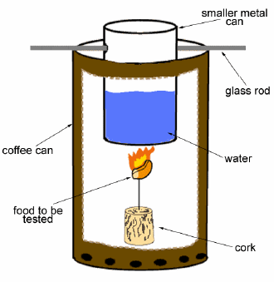
Calorimetry
Measures the amount of heat from a chemical or physical process

Slide 3
Measuring Heat
How did you measure energy in the experiment?

Slide 4
Exothermic Reaction
Chemical reactions release energy in different forms
Exothermic reactions release heat
What type of reaction did you do?

Slide 5
Heat Capacity
Specific heat of water = 4.18 J to heat 1 g 1° C
Heat is measured in Joules (J)
Calculate the amount of heat released in the reaction

Slide 6
Energy Statements T/F
Energy is found only in living things.
Justify your response.

Slide 7
Energy Statement T/F
Energy can be created.
Justify your response.

Slide 8
Energy Statement T/F
Energy cannot be transferred from one object to another.
Justify your statement.

Slide 9
Energy Statement T/F
One form of energy cannot be transformed into another form of energy.
Justify your statement.

